Slide 1
Car Price Prediction project
Name: Sumit Santra
Mentor: Shubham Yadav

Slide 2
Problem Statement
With the covid 19 impact in the market, we have seen lot of changes in the car market. Now some cars are in demand hence making them costly and some are not in demand hence cheaper. One of our clients works with small traders, who sell used cars. With the change in market due to covid 19 impact, our client is facing problems with their previous car price valuation machine learning models. So, they are looking for new machine learning models from new data. We have to make carprice valuation model. This project contains two phase

Slide 3
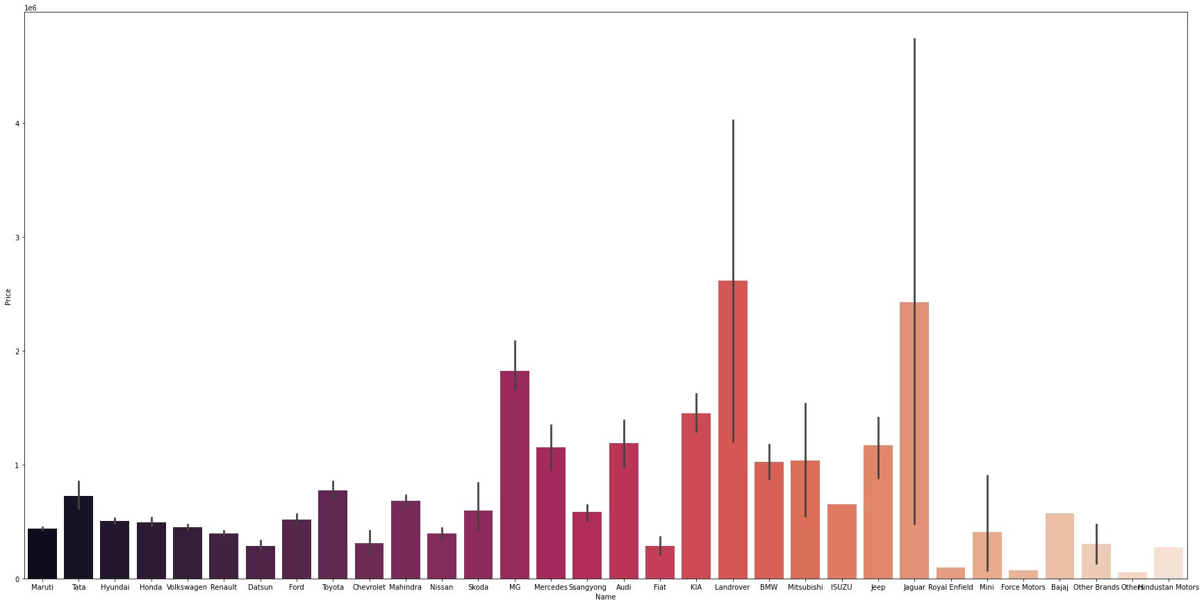
Exploratory data analysis
from above we can see that Toyota, Jaguar, Skoda, Honda has better selling Price in the market than other Car Companies

Slide 4
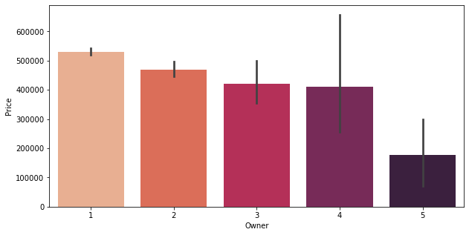
Exploratory data analysis
from above we can see that selling price of 2 owner is Highest followed by 1 owner
we can also see if the owner exceeds 2 then the selling price goes down drastically

Slide 5
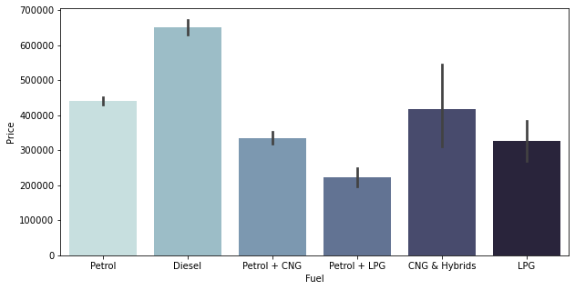
Exploratory data analysis
from above we can see Diesel engine has higher selling price as compared to other type of Engines

Slide 6
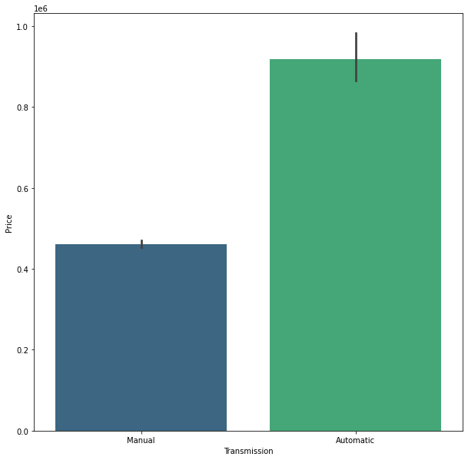
from above we can see that Automatic Transmission has Higher price than Manual Transmission i.e Technology has Higher price

Slide 7
Algorithms used
Linear Regression
Lasso Regression
Ridge Regression
Decision Tree Regression
Random Forest Regression
AdaBoost Regression
SVR
Kneighbors Regression
XGBRegressor
XGBRFRegressor

Slide 8
Step followed for problem solving
First I loaded the data in a Temp variable ds then I searched for Null values in the dataset I found out that there are 237 missing values in the transmission column so I filled the Nan rows with the mode of the column that is Manual.
After Removing all the Nan values and replacing them with the mode of the column I found another problem with the dataset In the Name column that is Maruti and Maruti Suzuki are the Same Company but they are categorised differently so by using replace method I replace all the Maruti Suzuki to Maruti now they are categorised as same there were also other Companies so I fixed them using this method
Then I came to model Column in that many Model of Same name are uppercase and Lower case so I changed all the model name to uppercase and reduced the Categories in the Dataset
After this my model was good to perform Machine Learning task and I performed Label Encoder to Convert Categories to Number as our model can only understand numbers.

Slide 9
Limitation of the project
There are some limitations from this project as we have scraped only 5000 rows from the Website so we may have not got all the Car Manufacturing Companies so it may mis calculate the price of the car which are not in the dataset
To improve the model we can add more data of the cars which are not in the dataset.

